Slide 1
Structuring System Requirements:
Logic Modeling

Slide 2
Logic Modeling
Data flow diagrams do not show the logic inside the processes
Logic modeling involves representing internal structure and functionality of processes depicted on a DFD
Logic modeling can also be used to show when processes on a DFD occur
9.<number>

Slide 3
Logic Modeling
Deliverables and Outcomes
  Structured English
  Decision Tables
  Decision Trees
  State-transition diagrams
  Sequence diagrams
  Activity diagrams
9.<number>

Slide 4
Modeling Logic with Structured English
Modified form of English used to specify the logic of information processes
Uses a subset of English
  Action verbs
  Noun phrases
  No adjectives or adverbs
No specific standards
9.<number>

Slide 5
Modeling Logic with Structured English
Similar to programming language
  If conditions
  Case statements
9.<number>

Slide 6
Modeling Logic with
Decision Tables
A matrix representation of the logic of a decision
Specifies the possible conditions and the resulting actions
Best used for complicated decision logic
9.<number>

Slide 7
Modeling Logic with
Decision Tables
Consists of three parts
  Condition stubs
    Lists condition relevant to decision
  Action stubs
    Actions that result from a given set of conditions
  Rules
    Specify which actions are to be followed for a given set of conditions
9.<number>

Slide 8
Modeling Logic with
Decision Tables
Indifferent Condition
  Condition whose value does not affect which action is taken for two or more rules
Standard procedure for creating decision tables
  Name the condition and values each condition can assume
  Name all possible actions that can occur
  List all rules
  Define the actions for each rule
  Simplify the table
9.<number>

Slide 9
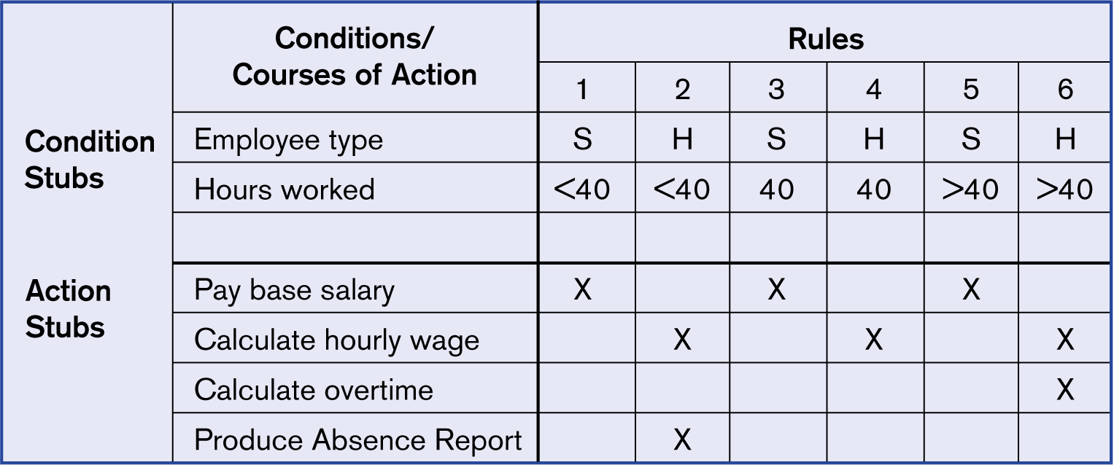
Figure 9-4
Complete decision table for payroll system example
9.<number>

Slide 10
Modeling Logic with Decision Trees
A graphical representation of a decision situation
Decision situation points are connected together by arcs and terminate in ovals
Two main components
  Decision points represented by nodes
  Actions represented by ovals
9.<number>

Slide 11
Modeling Logic with Decision Trees
Read from left to right
Each node corresponds to a numbered choice on a legend
All possible actions are listed on the far right
9.<number>

Slide 12
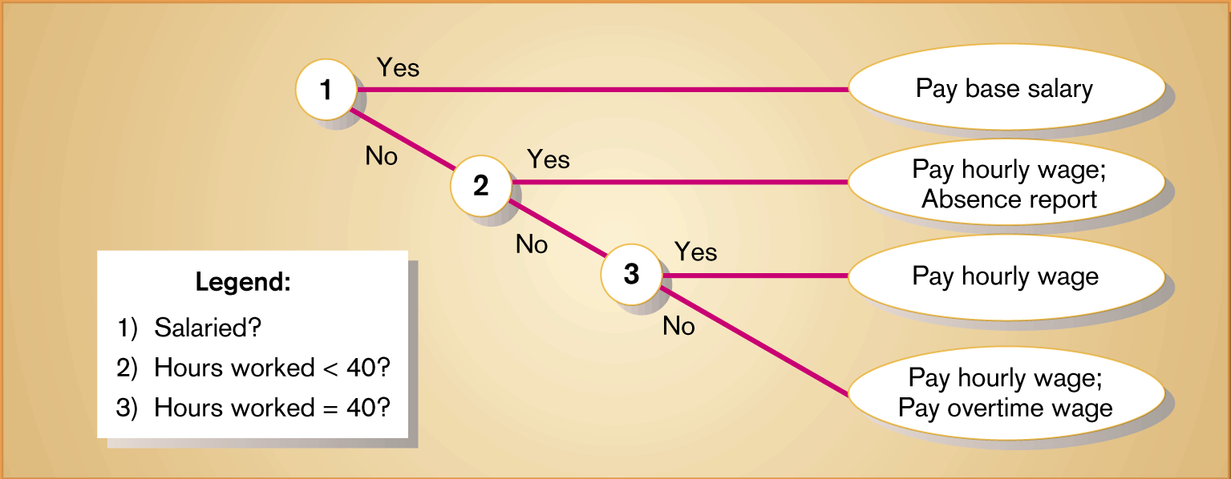
Figure 9-9
Decision tree representation of the decision logic in the decision tables in Figures 9-4 and 9-5, with only two choices per decision point
9.<number>

Slide 13
Deciding Among Structured English, Decision Tables and Decision Trees
Criteria | Structured English | Decision Tables | Decision Trees
Determining Conditions and Actions | Second Best | Third Best | Best
Transforming Conditions and Actions into Sequence | Best | Third Best | Best
Checking Consistency and Completeness | Third Best | Best | Best
9.<number>

Slide 14
Summary
Several methods of logic modeling
  Structured English
    Primarily communication technique for analysts and users
  Decision Tables
    Conditions are listed in condition stubs
    Possible actions are listed in action stubs
    Rules link conditions with actions
9.<number>

Slide 15
Summary
Decision Tables
  Lists all possible rules
Decision Trees
  Conditions are portrayed by decision points
  Values are represented by paths between decision points and ovals that contain actions
9.<number>

Slide 16
Summary
Comparison of Structured English, Decision Tables and Decision Trees
  Most studies show that decision trees are best for many criteria
  There is no best technique
  Analyst must be proficient in all three
9.<number>

